Slide 1
Ikaria Greece
New Blue Zone

Slide 2
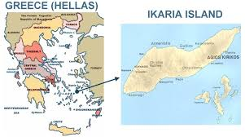
Notes:
Centanarians grew up here and have maintained the lifestyle. This area is unique to the other parts of Greece

Slide 3
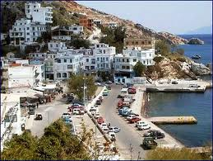
Notes:
Rugged hills and terrain is similar to Sardinia and contributes to the concept of move naturally

Slide 4
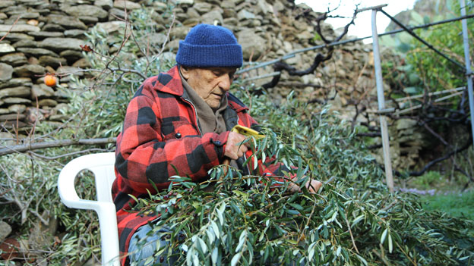
Medicine
Gardens
Notes:
The medicinal greens and herbs that they grown have about 10 times the anti oxidants as wine. These are added to stews, tea and other commonly eater components of their meals.

Slide 5
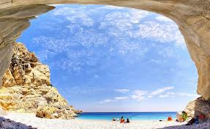
Stress free lifestyle
Start late, nap,
no time constraints
Notes:
Time constraints do not exist. This is a cultural norm and a part of the healthy environment there.

Slide 6

Get Your ZZZs
Take regular naps. People who nap at least five times a week for half an hour have 35% reduced chance of cardiovascular disease. Stress hormones also decrease when you’re napping.
Notes:
Napping for about 30 minutes several times a week reduces risks of many diseases and helps relieve stress. How does a nap in the sunshine sound?

Slide 7

Napping
Mid day napping: lower risk if heart disease by 1/3 more happy; less depressed
Lowers heart rate; reduces stress hormones; Better sleep; more work; more exercise

Slide 8
Nap – Dos/Don’ts
A nap during the afternoon
  restores wakefulness
  promotes performance and learning.
  10 min improves performance.
Naps of less than 30 min duration confer several benefits
Longer naps are associated with a loss of productivity and sleep inertia.
  .
Notes:
Nap wisely, and don’t over do.

Slide 9
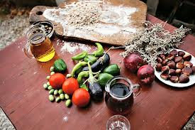
Unique
Diet unlike other
Mediterranean versions. Mostly vegetarian.
Notes:
The Mediterranean diet in Ikaria differs from that in many other European countries, but has some similar aspects. That being lots of vegetables, healthy oils and cheese.

Slide 10
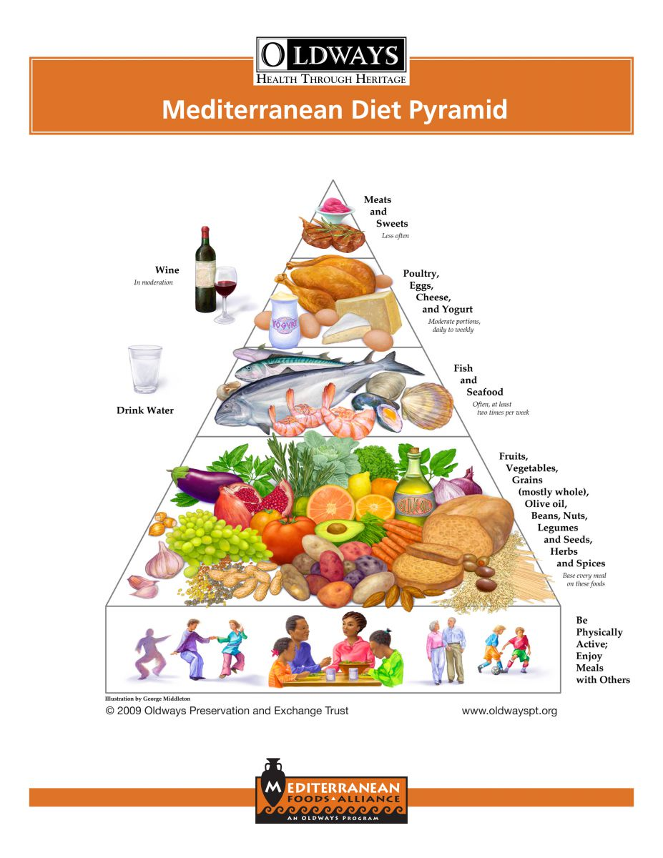
Mediterranean Diet
Pyramid
Gold Standard
Introduced by Harvard School of Public Health, and the European Office of the World Health Organization Classic Mediterranean Diet and Pyramid in 1993.
Notes:
Following the Mediterrean diet has been shown to be the healthiest option

Slide 11
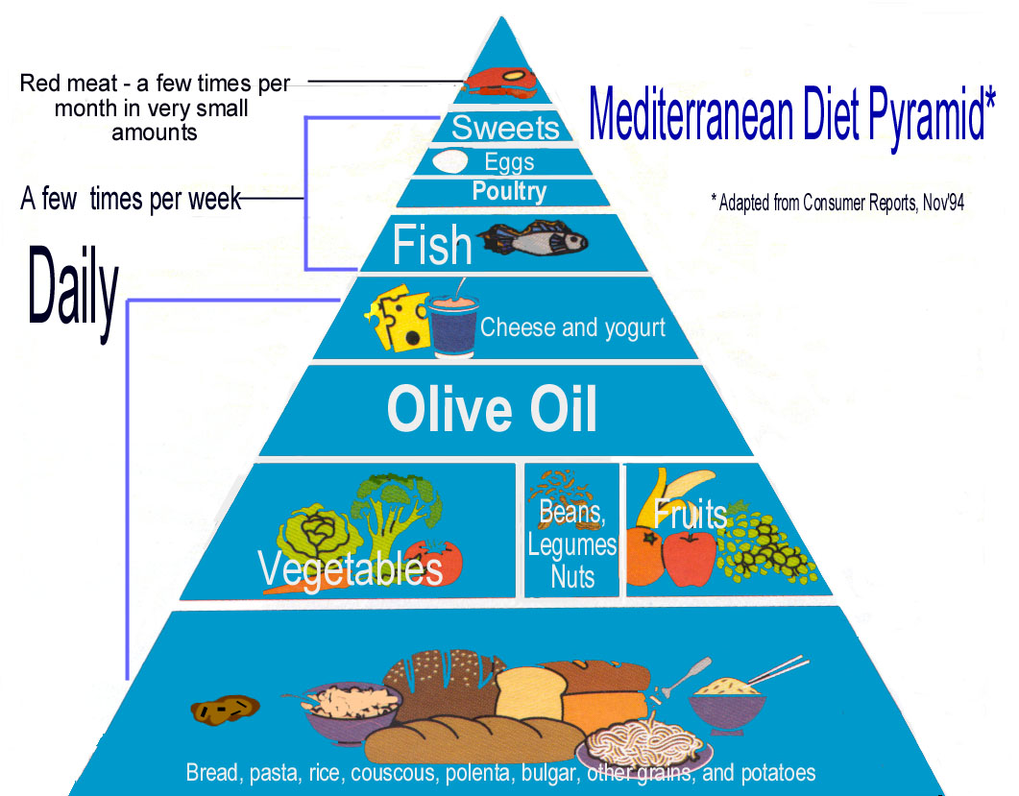
Mediterranean Diet:
Ikarian style: Grain Beans veges and olive oil; seasonal, veges are center stage/ finish with olive oil (served raw). Polyphenols'/antioxidants. Also drink wine.

Slide 12
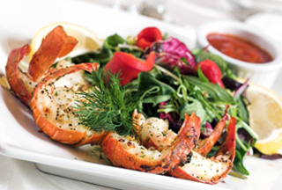
Mediterranean Diet
Dietary Traditions
“Poor Diet
It was based on the diets consumed in Crete, Greece and southern Italy 1960.
  Chronic disease rate lowest
  Life expectancy Highest
The “poor” diet
  fruits and vegetables, beans and nuts, healthy grains, fish, olive oil
  small amounts of dairy, and red wine
Notes:
Many have claimed this is the diet of the poor due to lack of meat. It is in fact the diet of those rich in good health.

Slide 13
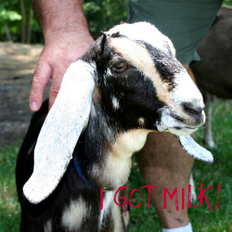
Goat’s Milk
Polymers or proteins that help stomach reproduce cells m east to digest; helps those who are lactose intolerant
Potential for treating gastro intestinal conditions
Good bacteria that naturally kill other bacteria found in food
Notes:
Don’t forget about the importance of goat’s milk. Elders especially benefit from this.

Slide 14

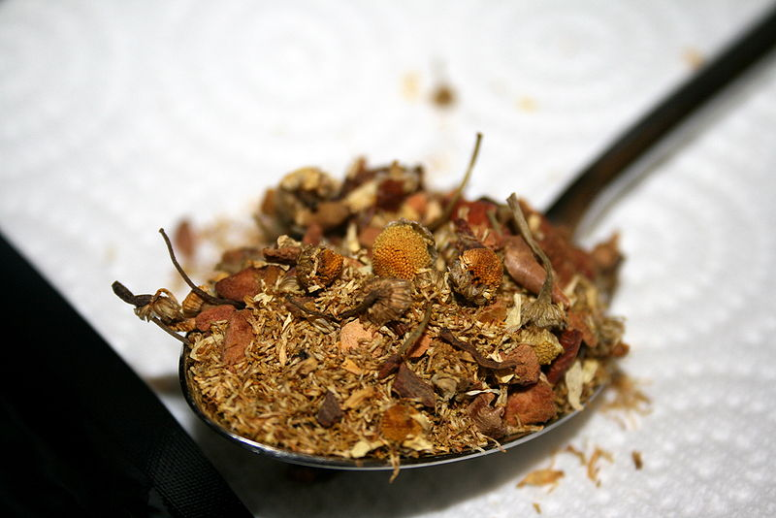
Herbal Tea
Diuretic
The herbal teas are often drunk with raw, unprocessed local honey that is unique to the island, which has antioxidant, anti inflammatory and anti bacterial properties. As the teas are initially prepared from fresh herbs that haven’t been bruised or broken until blended, the medicinal properties are not compromised.
Rosemary, chamomile, wild mint, sage and mountain tea from the Sideritis species are commonly used herbs in Ikaria and also all over Greece that are made into herbal teas.
Notes:
As in many countries tea and the associated antioxidants and natural healers contributes to the longevity and good health of Ikarians. The tea itself and the preparation of the tea matters.

Slide 15
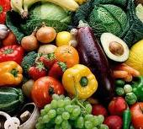
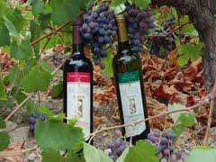
Combinations
Plant Based Diet
Wine
Increased flavonoid consumption
Notes:
Science shows us that eating a vegetable diet with wine adds to the flavonoid consumption. More of the good stuff. Also sour dough bread helps lower blood sugar.

Slide 16
Flavonoids -antioxidants
Flavonoids may help provide protection against
  cancer,
  aging,
  atherosclerosis,
  ischemic injury,
  Parkinson's and Alzheimer's
  Epidemiological studies have shown that flavonoid intake is inversely related to mortality from coronary heart disease and to the incidence of heart attacks.
Notes:
More and more evidence supports the value of having a diet that is plant based as a natural disease prevention strategy.

Slide 17
Key Dietary Elements = 4 years
Herbal tea
Beans
Olive Oil
Little Meat and dairy
little Fish
Plant based diet and wine
Notes:
In summary, eat and drink as the Ikarians

Slide 18
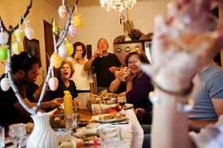
Family Meals
Other vital elements of the Mediterranean Diet
sharing meals with others, and fostering a deep appreciation for the pleasures of eating healthy and delicious foods
Notes:
Eat as they do in the types of food, but also enjoy the food with friends and good conversation. Make it fun and social

Slide 19
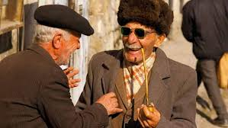
Social Networking
Elders stay connected to each other and the
Community at large.
Notes:
Ikarians know each other and have a strong sense of community. They patrol the area not to be nosey but because they care and are concerned. This keeps everyone hones and at their best.

Slide 20
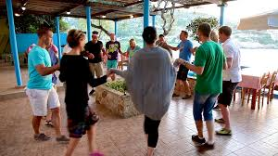
Social Networking
They regularly dine, dance and share time.
Notes:
Coming together to celebrate and have fun in Ikaria represents a way of life.

Slide 21
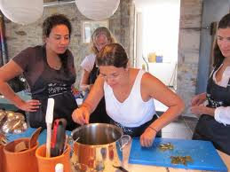
Social Connectivity
Connecting social: over 65 chances of dying nearly triples without key connections
Notes:
Right tribe and communicating support good health, prevents depression and adds years.

Slide 22
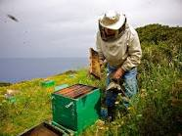
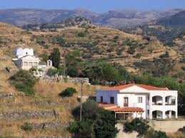
Regular Daily Activity
People traditionally have farming or herding jobs and live in a mountainous terrain, which keep them active throughout life.
Notes:
Gardening and active jobs contribute to their daily physical activity.

Slide 23
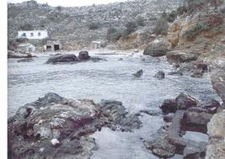
Hot Springs – revive and rejuvenate
Notes:
Other things like their hot springs are said to have healthy quality. We have our own Warm Springs in GA.

Slide 24
Ikaria Social Norms
Garden
Eat Healthy/drink herbal tea
Rest/nap
Walk
Do not stress about time
Connect to others everywhere and mind everyone’s best interest
Connect spiritually
Notes:
Healthy social norms matter when it comes to longevity.

Slide 25

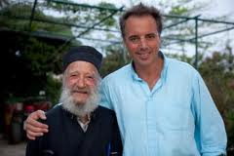
Ikaria Elders
Maintain purpose through
Work, family and connections.
Low rates of disease including
Dementia.
Notes:
As in other Blue Zones, elders are revered and respected. They also maintain a sense of purpose throughout their lives.

Slide 26
Building Blue Zones in the US
Possible:
  Planning: Who, what, how
  Implementing power of 9
    Strategies
  Challenges:
    Overcoming
  Outcomes
Not Likely:
  Social Barriers
  Emotional, mental barriers
  Funding
  Political
  Other

Slide 27
Vitality Cities Blue Zones strategic implementation
V Vitality Cities
V
Results: Web
Rodondo to Okinawa V
Notes:
Go to the links above to learn more about the Vitality cities projects. This project brings lessons from the Blue Zones to cities in the US. It can and is working here.

Slide 28
Successes
Success Stories:
The city built and rented 46 new community gardens.
44% of the adult population participated in walking moais, logging over 75 million steps in one year.
Nearly 1,000 people attended one of Richard Leider’s Purpose workshops.
Schools banned eating in hallways and stopped selling candy for fundraisers.
Outcomes After One Year:
Participants added an average 2.9 (projected) years to their lifespan.
Healthcare claims for city workers dropped 49%.
Participating businesses saw a 21% decline in absenteeism.
“The Blue Zones Project helped our community set amazing, aggressive, and achievable strategies that moved the public health agenda further in ten months than I could have expected in ten years.” – Lois Ahern, Director of Freeborn County Health (retired)

